Slide 1
NC Charter School Overview
By the North Carolina Association for Public Charter Schools

Slide 2
NCAPCS Mission
Advancing quality educational opportunities for all North Carolina children by supporting and expanding high-quality public charter schools!

Slide 3
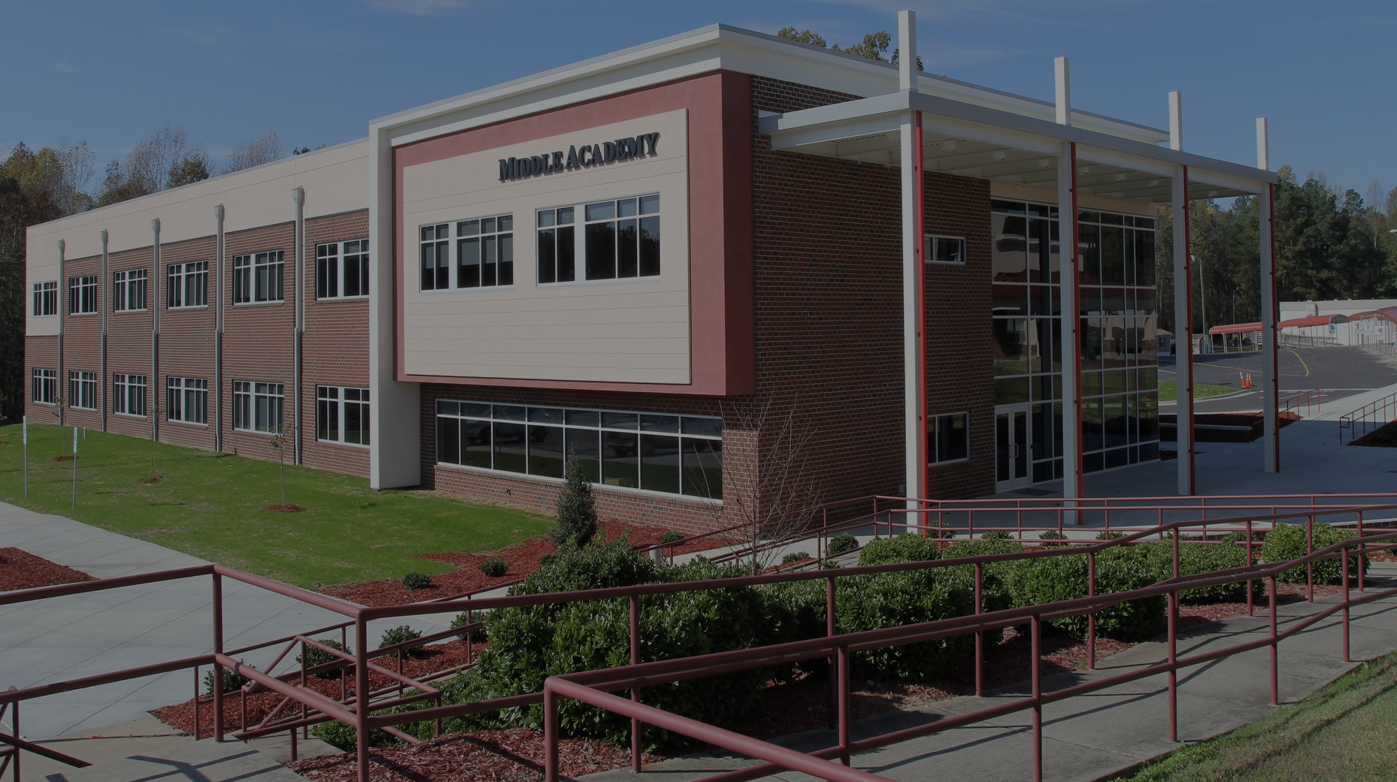
What is a charter school?
Authorized by the State Board of Education, charter schools are tuition-free public schools of choice that are operated by independent non-profit boards of directors. Because of this level of autonomy, charter schools have more flexibility in their curricula and operations. However, they are still required to meet state testing standards because they are publicly funded.

Slide 4
NC Charter School Quick Figures
Number of charter schools = 201 (2020-2021 school year)
Number of students served = 120,056 (2019-2020 school year)
Total number of NC public school students = 1,555,384 (2019-2020 school year)
Percent of students served = 7.7%
Number of teachers = over 6,500

Slide 5
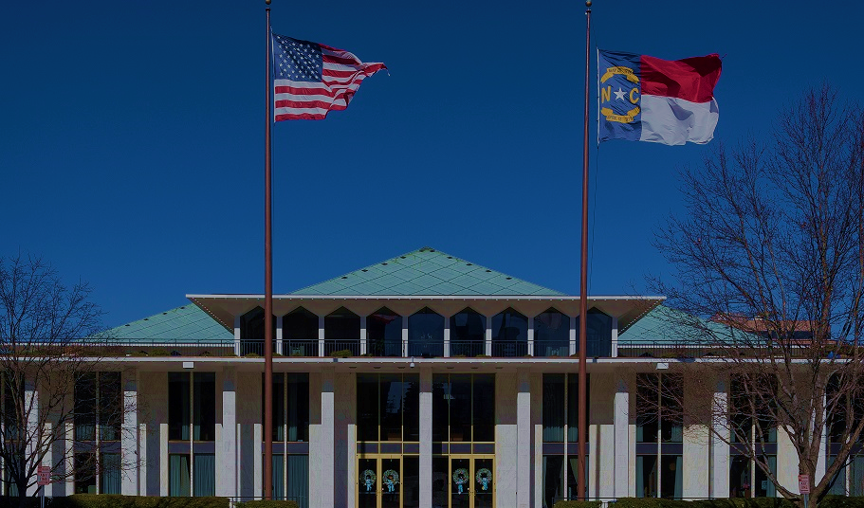
Timeline
1996 – House Bill 955 passes authorizing the creation and funding of up to 100 charter schools statewide.
2011 – Senate Bill 8 passes removing the 100-charter-school cap.
2012 – The NC Assoc. for Public Charter Schools is founded.
2018 – NC reaches educating 100,000 students in charter schools.
2020 – NC reaches more than 200 charter schools in operation.

Slide 6
Charter School Myths
Myth 1: “Charter schools are unaccountable, private schools that take money away from district schools.”
Truth: Charter schools are 100% accountable to the State Board of Education. Charter schools that don’t perform academically face the most serious consequence: closure.
Charter school students are typically funded at $0.73/dollar compared to district school students. Charter schools receive no capital funding for facilities.

Slide 7
Charter School Myths
Myth 2: “Charter schools don’t serve a diverse population of students. They get to hand pick their students to populate their schools.”
Truth: Charter schools operate on a lottery system that does not discriminate based on race, wealth, religion, gender, or any other reason. While Hispanic students attend charter school less frequently in NC, charter schools educate a greater percentage of Black, Asian, and Pacific Islander students by percentage.

Slide 8
Charter School Myths
Myth 3: “Charter schools exclude economically disadvantaged students by not providing transportation or food.”
Truth: There are a number of charter schools that provide transportation and food without receiving any funding to do so. While they are not required to participate in the Federal Free Lunch Program or provide buses, they must provide an explanation to the SBE if they choose not to offer meals or transportation before they are allowed to open. Most charter schools do not enroll students from a single city or county. In fact, most of them enroll students from multiple LEAs, for some as many as ten!

Slide 9
Charter School Myths
Myth 4: “Charter schools have lower academic performance than district schools.”
Truth: Charter schools academically outperform district schools. Traditional NC public schools have an average academic proficiency score of 56.1% while NC charter schools have a proficiency score of 66.7%.

Slide 10
Who oversees the NC charter school sector?
The NC Department of Public Instruction (NCDPI) oversees the state charter school sector, specifically the Office of Charter Schools (OCS), Charter School Advisory Board (CSAB), and State Board of Education (SBE). Charters are solely granted by the SBE and must be renewed periodically.

Slide 11
How are students enrolled into a charter school?
Parents may apply to any charter school in NC, online or in-person, if their child is eligible to attend an NC public school. If a school receives more applications than its capacity, a lottery is conducted with exemptions for staff children and siblings of current students. Discrimination based on race, national origin, or religion is prohibited. Students cannot be picked.

Slide 12
How are charter schools funded?
Like district schools, charter schools charge no tuition. They receive most of their funding from federal, state, and local governments while the rest is through fundraising.
Federal Most federal funds are targeted to specific student population, i.e. children with disabilities, children in poverty; vocational education (grades 7-12). An application is required for each federal grant. Federal funds for children with special needs will be allotted based on a formula, which includes the number of children in a December 1st headcount. Federal funds are allotted after grant awards are received from the Department of Education and approval from the program staff
State Each charter school receives a per-pupil allotment based on the county in which it is located.
Local Government Each charter school receives a per-pupil share of local funds based on enrollment and the districts from which parents send students to the school. Certain local funds are exempt from being shared with charters including most local education taxes.
Fundraising Charter schools, like any non-profit, can raise funds. Capital fundraising (i.e. real estate & facilities) is most common because charters receive no state capital funds and local governments are prohibited from providing capital funds.

Slide 13
How are new charter schools created?
A group of state citizens form a non-profit board and submit an application to the Office of Charter Schools where it is reviewed for completion. Complete applications are presented to the CSAB who vote to recommend them to the SBE for final approval. Approved schools enter the planning year during which benchmarks must be met or the charter could be delayed or rescinded. Upon completion, schools may open the upcoming academic year.

Slide 14
What flexibility do charters have that traditional schools do not?
Start & End Dates While each charter school must adhere to the state requirements for the number of school days, it may choose its start or end date.
Curriculum Charter schools are not required to follow the state curriculum but must meet state testing standards.
Transportation & Meals Charters are not required to provide transportation or meals. However, they must ensure no student is prevented from attending because of lack of those services.
Staff Pay Charter schools are not required to pay staff by the state pay scale enabling them to pay better teachers & administrators more
Certification Charter schools must have at least 50% of their teachers certified enabling them to bring other professionals to teach in their field of expertise.

Slide 15
Do charter schools receive funding for EC students?
Yes. Like district schools, charter schools receive a per-pupil allotment for each EC student plus reserve funds for severe cases. EC funding is limited to 12.5% of enrolled students. Because EC student enrollment exceeds this percentage at many charter schools, this limit can be cumbersome.

Slide 16
Do charter schools “take” funding from traditional schools?
No. Charter schools share the costs that would be paid solely by the district if only district schools existed. For example, districts with high growth rates must supply and maintain additional schools to accommodate the population. Since charter schools must pay for their own facilities, costs are shared between the district and charter schools in or near that district.

Slide 17
How are charter schools accountable for taxpayer dollars?
First, charters must adhere to the contents of their charter granted by the SBE. There are also unscheduled school visits by OCS consultants, an annual CPA audit, and the Charter School Financial Performance Guide. Charter schools must provide documentation for the state to pay their bills. Board members receive no compensation and are subject to state open-meeting and nepotism statutes.

Slide 18
What does the NC Association for Public Charter Schools do?
Advocacy
Education
Support

Slide 19
Advocacy
Kilpatrick Townsend Government Relations Team
Leadership Roundtables and School Visits
Legislative Agenda Committee
Visits with Legislators, Office of Charter Schools, Charter School Advisory Board, and State Board of Education
2020 Legislative Session Overview and Candidate Questionnaire
School Safety Equipment Grant Eligibility
Top Federal Advocate
Charter School Lobby Day at General Assembly

Slide 20
Education
Communications: Op-eds, press releases, media statements, and interviews
Newsletters: Matters of Principal and Preferred Partners
Legislative Updates
Emails, Calls to Action, Policy Paper to SBE
Events: National School Choice Week, Civic Organizations, School Ceremonies, BB&T Symposium
“Somewhere to Learn”
“Charter Schools Top the List of Best NC Public High Schools”
“The Teacher’s Voice”
“Stymied by Funding”
“Charter Schools Are the Solution--Not the Problem--To Our Inequitable Education System”
“Diverse Teaching at NC Charter Schools Has Outsize Impact on Minority Students”
“NC’s Charter Schools off to a Strong Start in 2019”

Slide 21
Support
Job Fairs, Teacher Recruitment Fairs, Facilities Financing Workshop, Author Visits, Grant-Writing Training, Literacy Workshop, FREE Governance Training, New School Support, Vendor Fair
Website: Laws and Policies, Business Directory, Job Board, Articles, and Member Portal
Discounts on Products and Services
FREE Webinars: Employment Law, HR, Leadership, Marketing
Annual Conference

Slide 22
NC Association for Public Charter Schools Membership
School membership dues are calculated at $3.50 per student based on the first 20-days’ ADM of the previous year.
First year schools and National Heritage Academies’ schools enjoy a discount of $1.75 per student.

Slide 23
References
[Dan Forest]. (2016, Feb 3). North Carolina Public Charter Schools Myths v Facts [Video File]. Retrieved from https://www.youtube.com/watch?time_continue=1&v=jeiA9uzancY
North Carolina Department of Public Instruction (NCDPI). (2020 July 20). Average Daily Membership and Membership Last Day by LEA (ADM & MLD): Best 1 OF 2 Allotted ADM for 2019-2020 School Year (LEA). Retrieved from http://www.ncpublicschools.org/fbs/accounting/data/
North Carolina Department of Public Instruction (NCDPI). (2020 August 7). Educational Directory and Demographical Information Exchange (EDDIE): Active Charter Schools Report. Retrieved from http://apps.schools.nc.gov/ords/f?p=125:705:::NO:RP,705::&cs=3y9snyOhbOgbwlfUo_vO5LsCfIcy5d2LOstWvKqK4q7TjCjgWb_TU-MknfAUBBFiGJzvgz9D_gSu4lJshZsS44w

Slide 24
For More Information
Rhonda Dillingham
Executive Director
NC Association for Public Charter Schools
(336) 669-9996
rhonda@ncpubliccharters.org

